Slide 1
GALAXY.PK
OOPS PROJECT
Wajid khan 19b-109-se

Slide 2
Admin:
Admin can add product, manage product , update product.
Give catogery image and name to the product to to save

Slide 3
User:
User can order by selecting specific on home page.
User click and new window appears and user can checkout.
User can make payment both online and cash on delivery.

Slide 4
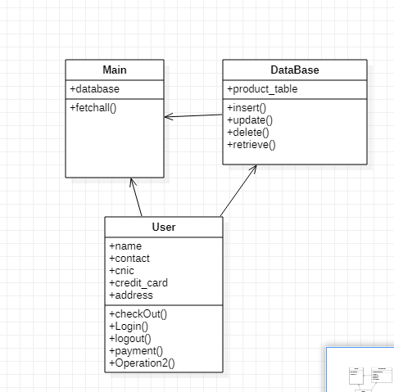
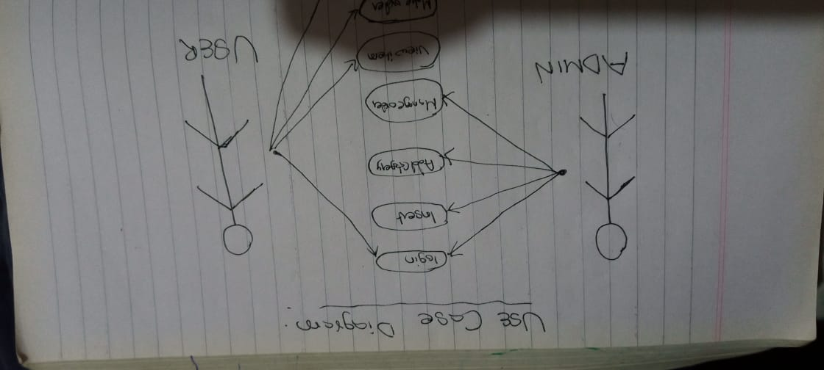
Screen SHOTS:

Slide 6
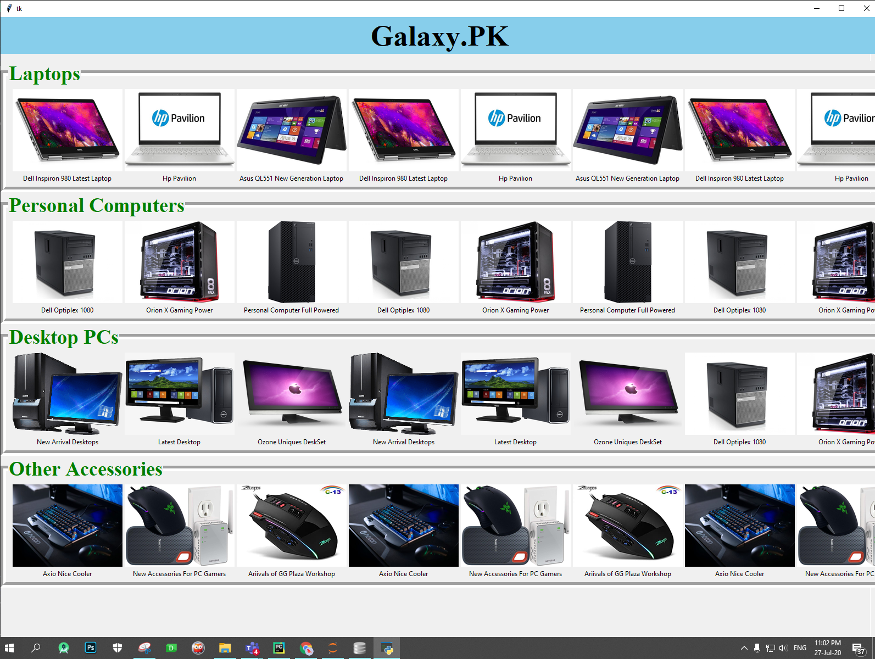

Slide 7
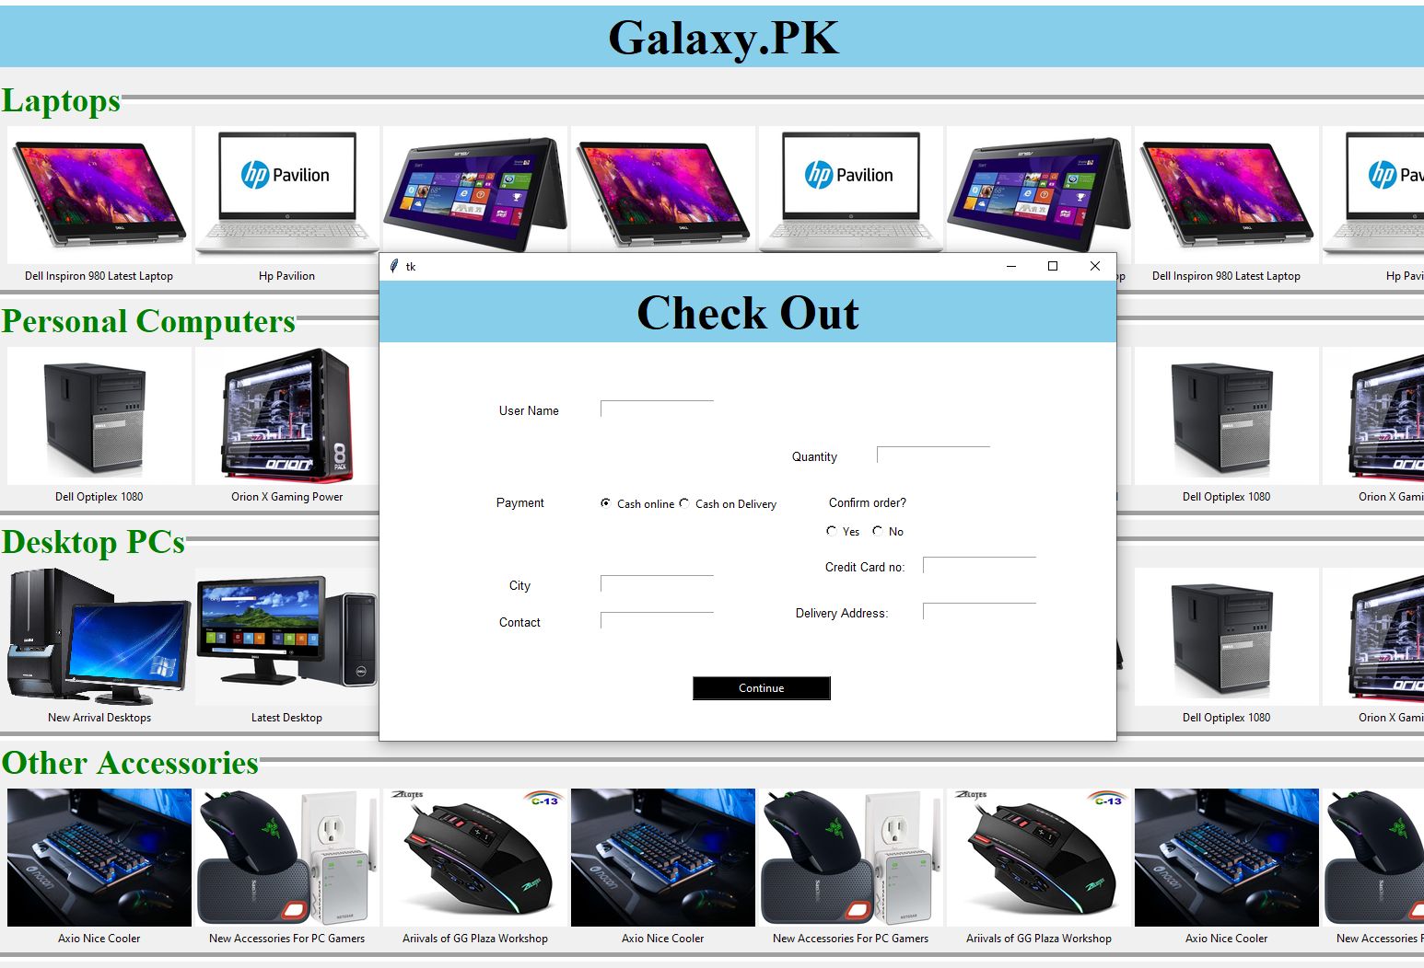

Slide 8
